Slide 1
Coursaera Capstone Project
The Battle of the Neigborhoods

Slide 2
Introduction And problem Description
The surroundings of Lawrence park neighbourhood appears to have a lot of schools and universities.
This implies that there are a lot of young people residing or moving in and out of this neighbourhood and there might be a demand for business that are aimed towards the younger generation.
The problem description here is what kind of business can a businessman undertake in this neighbourhood

Slide 3
Data
The data required is available on the Wikipedia page and foursquare API can be used.
https://en.wikipedia.org/wiki/List_of_postal_codes_of_Canada:_M
Using the data available in trusted sources, I will be conducting clustering and neighborhood based analysis leveraging primarily Foursquare APIs and tools such as KNN and relevant unsupervised learning methods to deliver recommendations options.

Slide 4
METHODOLOGY
Using the list of neighborhoods, we connect to the Foursquare API to gather information about venues inside near of Central Toronto borough. We take the radius to be 1000 meter. It means that we have asked Foursquare to find venues that are at most 1000 meter far from Central Toronto borough.
Processing the Data and Creating a Data Frame for All the Venues inside the Central Toronto borough. This actions are working with language Python.
When the data is completely ordered, we will perform processing on that raw data to find our desirable features for each venue. Our main feature is the category of that venue. After this stage, the column "Venue's Category" will be One-hot encoded and different venues will have different feature-columns. After On-hot encoding we will integrate all venues columns to one column and joint columns to "Total Joints" column. After applying k-Means Clustering of Machine Learning Techniques.

Slide 5
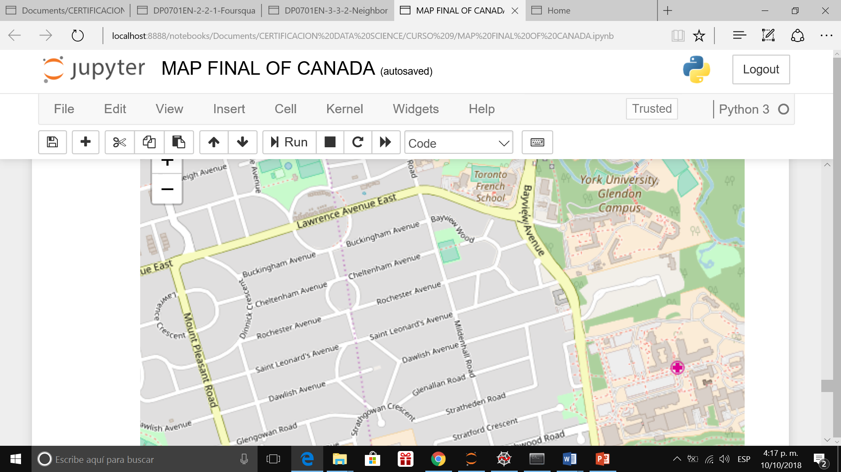
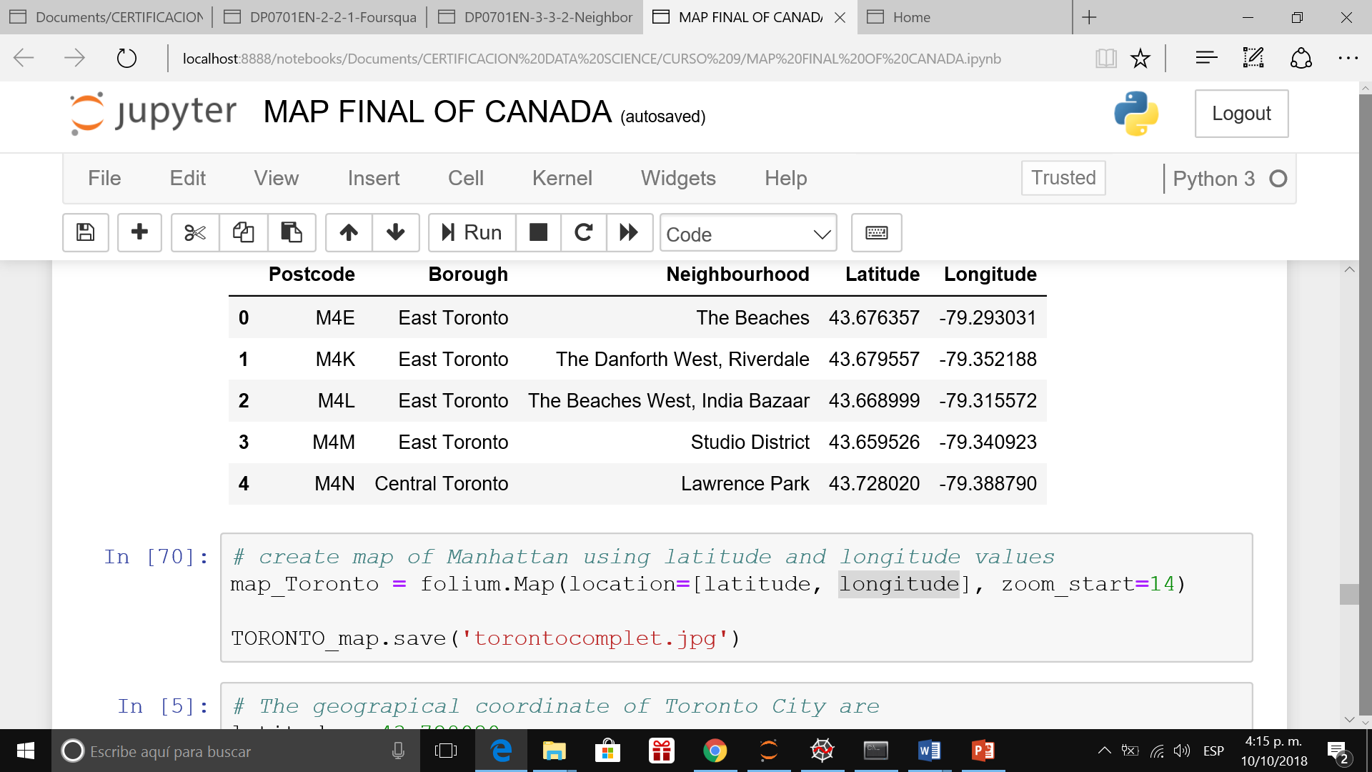
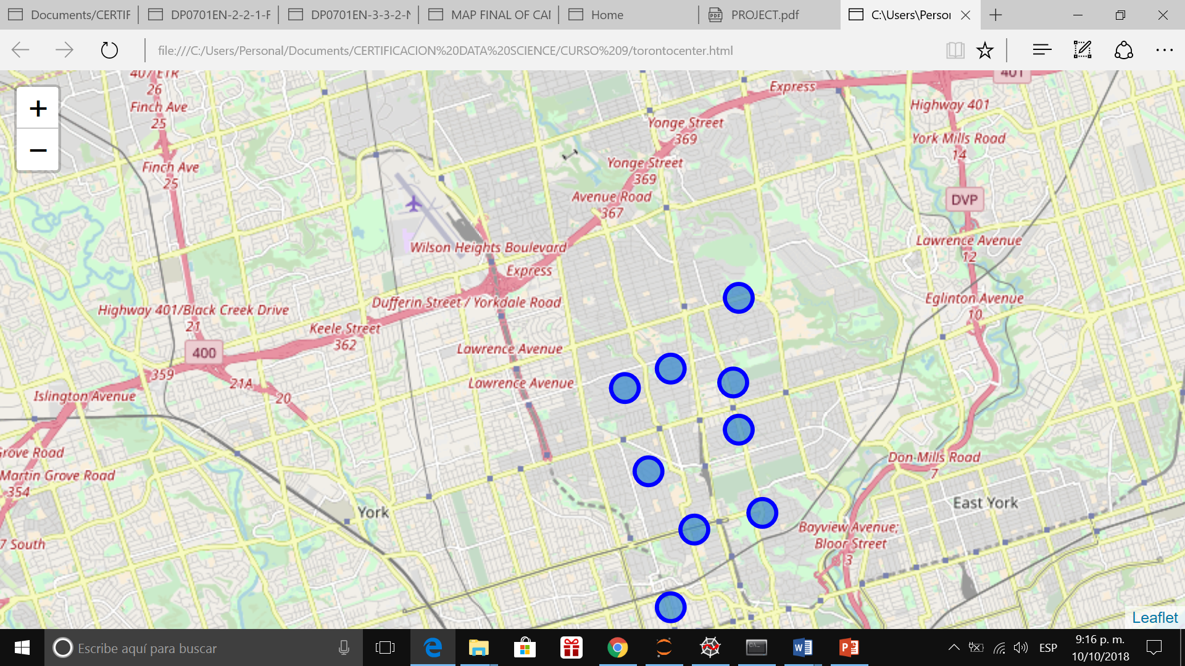
TABLE OF DATA AND MAP

Slide 6
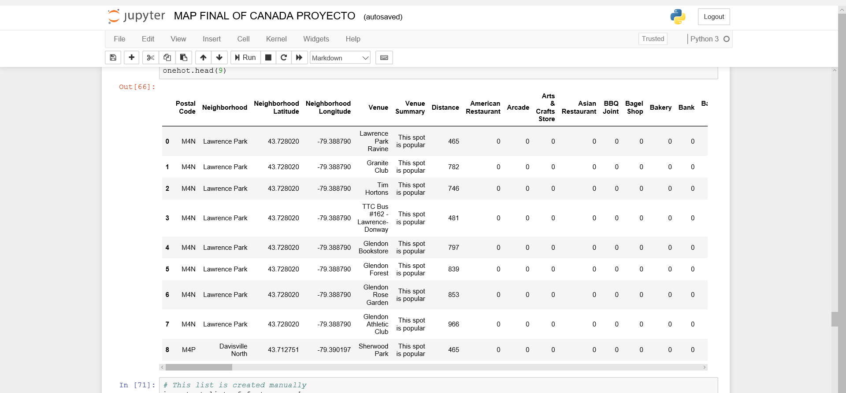
CENTRAL TORONTO BOROUGH USING FOURSQUARE

Slide 7
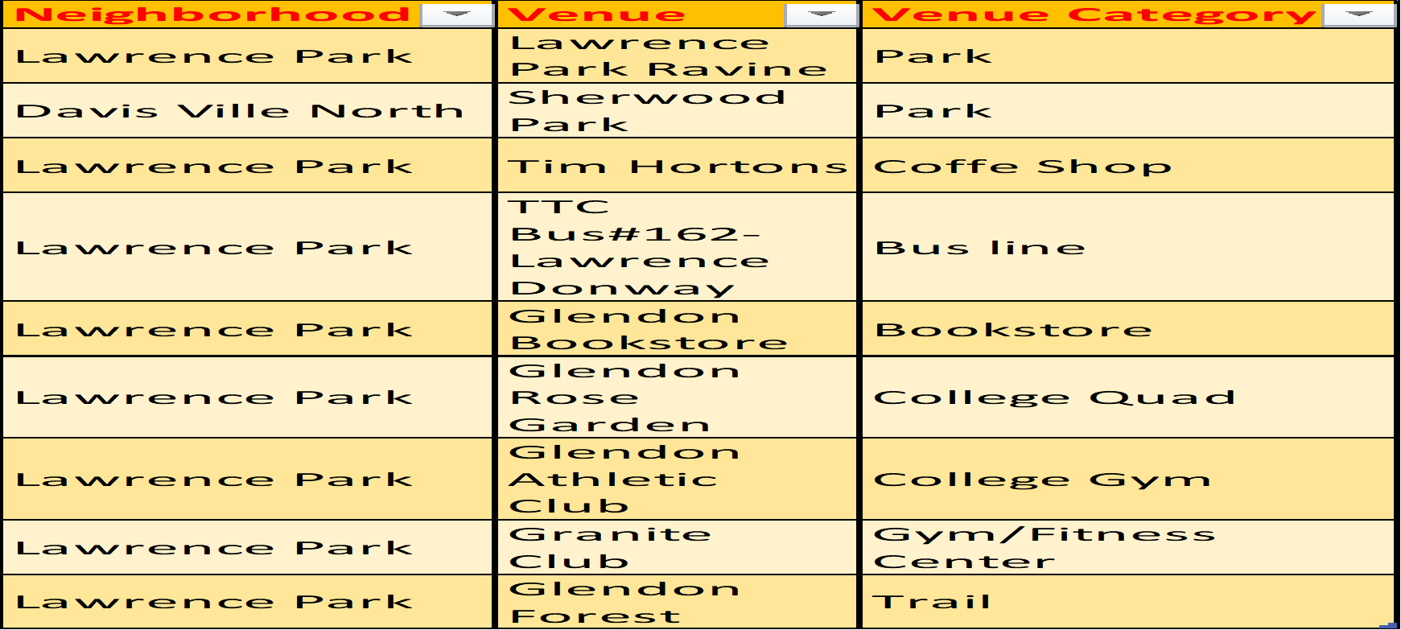
RESULT
There are two Neighborhood in Central Toronto Borough, Lawrence Park and Davis Ville North.
There are 9 venues in Central Toronto Borough.
There are not American Restaurant, Arcade, Art and Crafts Store, Asian Restaurant, Shop, Bakery, Bank.

Slide 8
CONCLUSION
Based on the analysis we can see THAT THERE IS NO ARCADE in the neighborhood, hence A BUSINESS RELATED TO ARCADE can be undertaken in the lawerence park area.

